Slide 1
DEMAND FORECASTING USING MACHINE LEARNING
Presented by: Group Members

Slide 2
Introduction
Demand forecasting predicts future product demand based on past data.
It helps companies plan inventory, production, and supply chain.
Machine learning models learn patterns from historical data.
Accurate forecasting reduces stockouts and overstocking.

Slide 3
Objectives
Understand the demand dataset and its structure.
Apply machine learning models to forecast demand.
Compare model performance using evaluation metrics.
Provide better demand predictions for decision making.

Slide 4
Dataset Description
Time-series dataset containing historical demand/sales values.
Each record represents demand on a particular date.
Date column is converted to separate Year, Month, and Day features.
Dataset is cleaned to remove missing and inconsistent values.

Slide 5
Data Preprocessing
Converted 'date' column into proper datetime format.
Extracted new features: year, month, and day from date.
Removed unwanted or duplicate columns if any.
Scaled/encoded features where required for model training.

Slide 6
Exploratory Data Analysis (EDA)
Plotted demand over time to observe trends and patterns.
Identified high-demand and low-demand periods.
Checked for seasonality and monthly variations in demand.
Used graphs to understand overall behaviour of demand data.

Slide 7
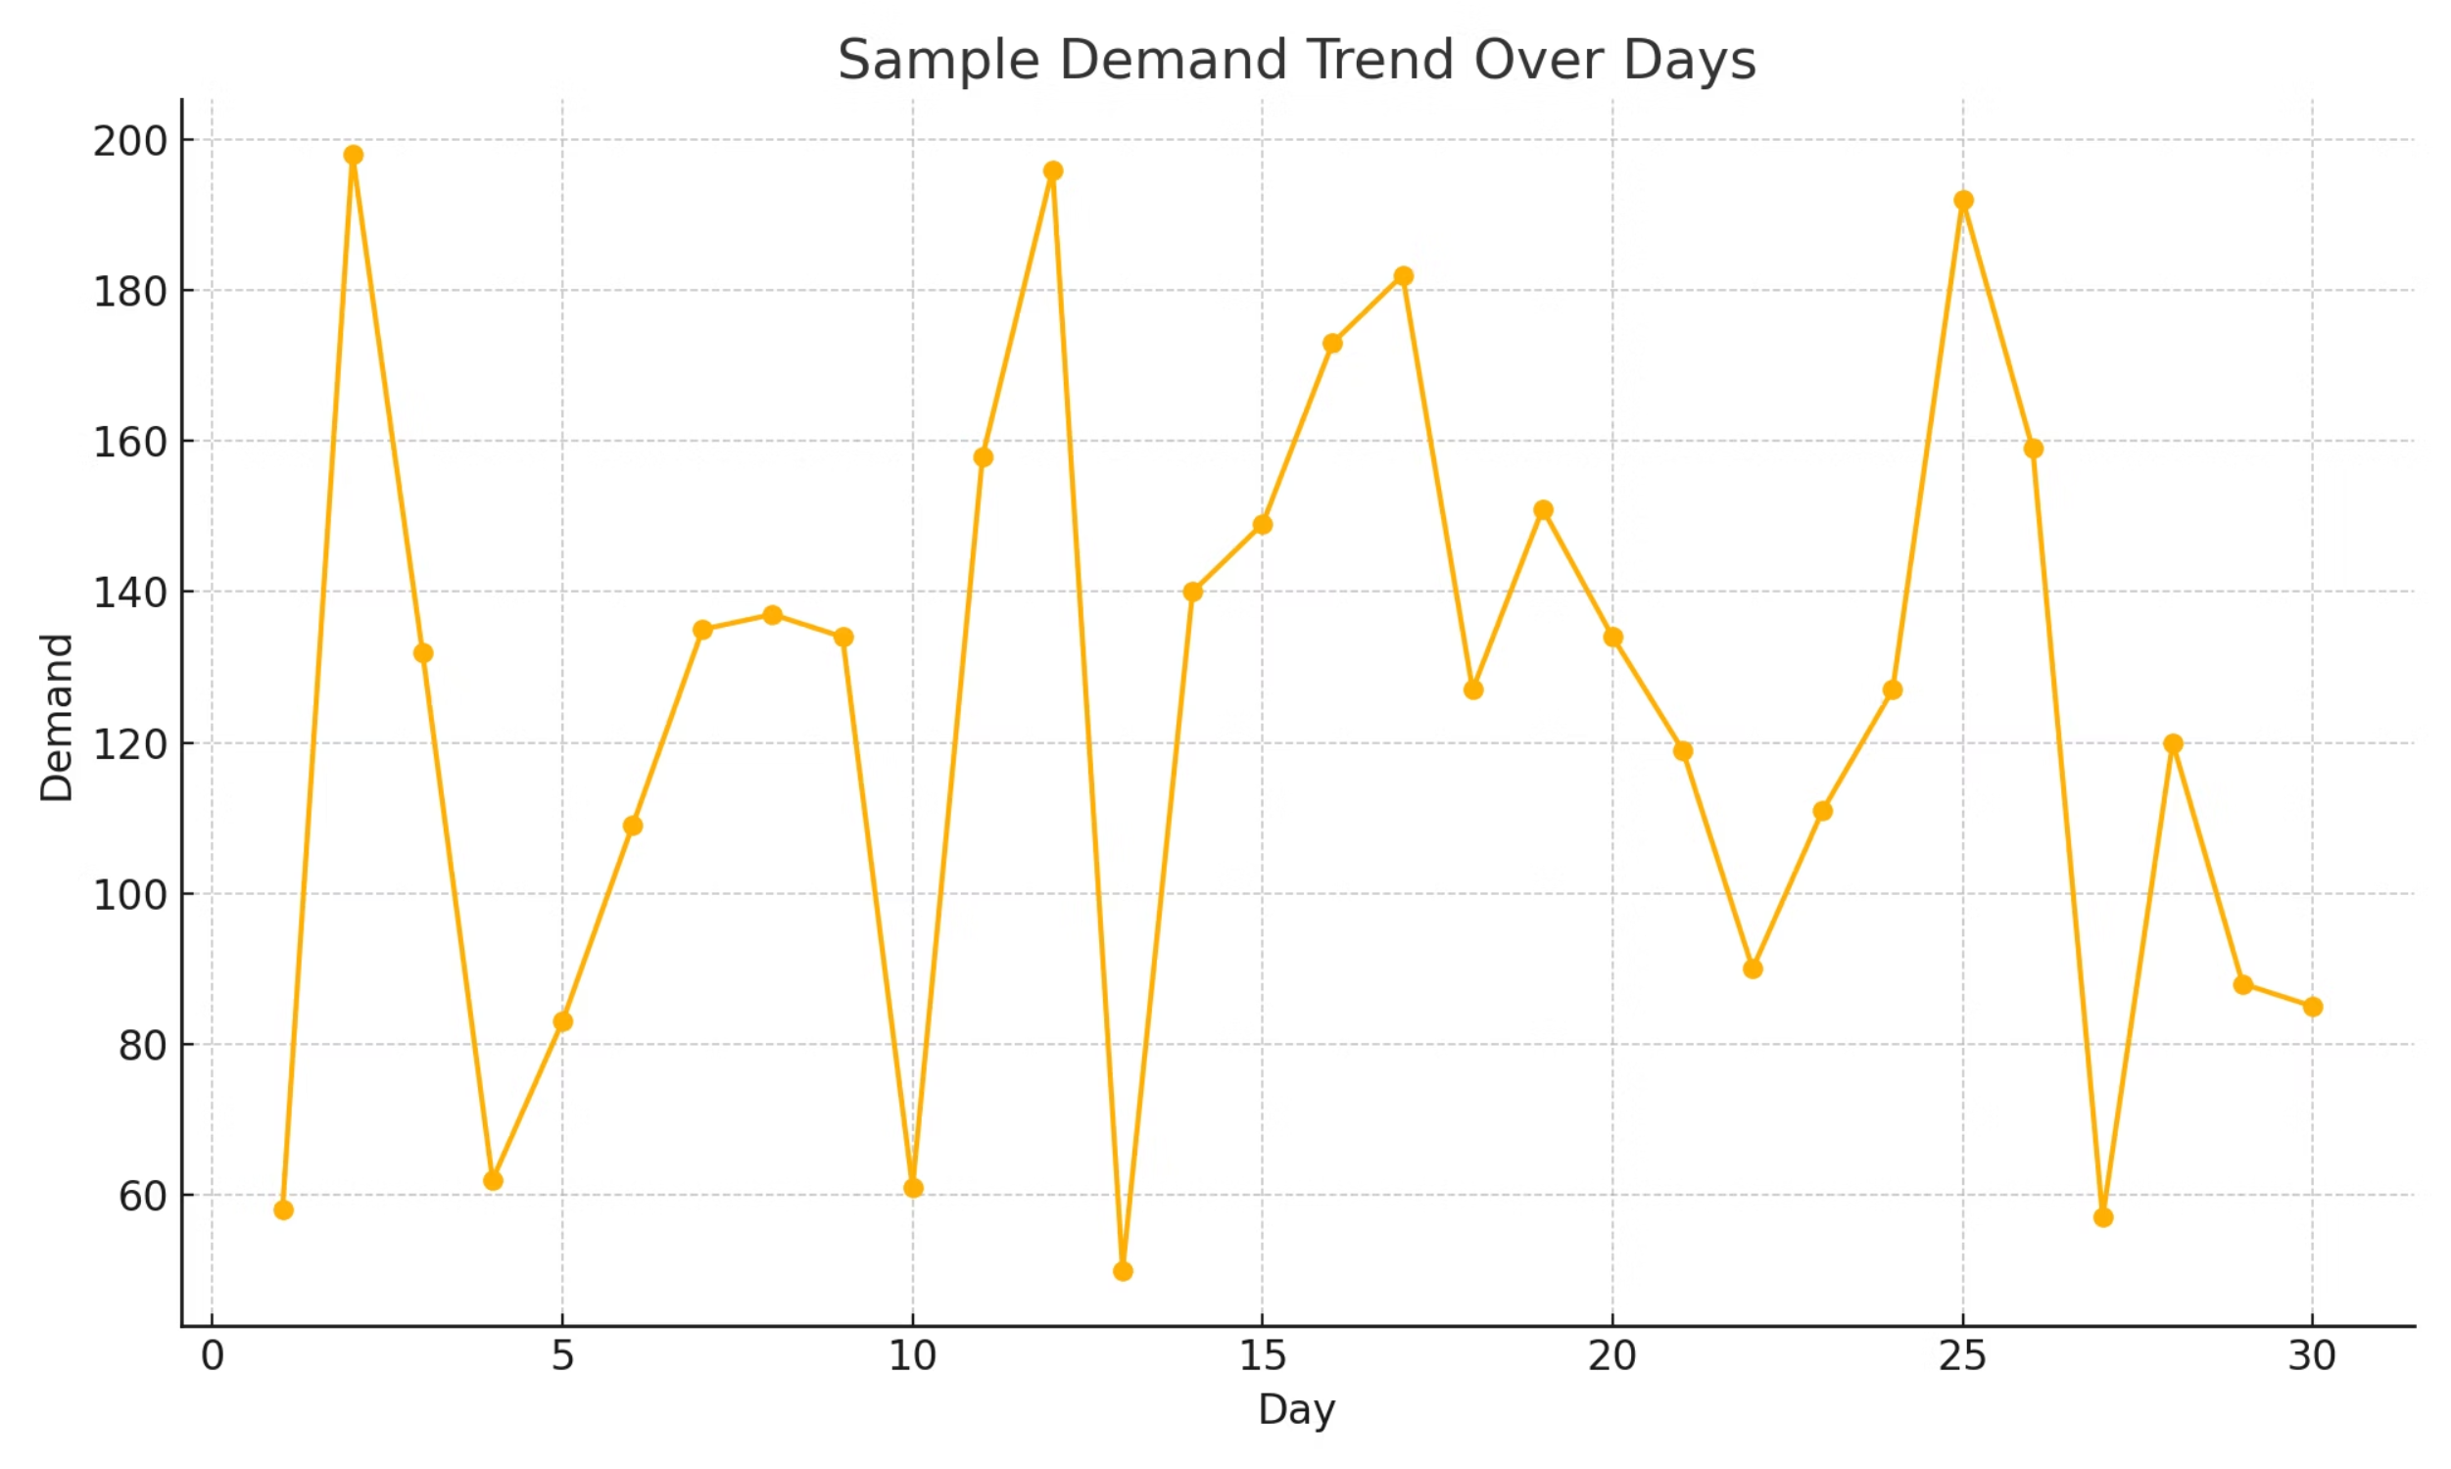
EDA – Demand Trend Example

Slide 8
Machine Learning Models Used
Linear Regression – baseline model for continuous demand.
Decision Tree Regressor – captures non-linear relationships.
XGBoost Regressor – gradient boosting for better accuracy.
Models are trained using historical demand and date features.

Slide 9
Model Training & Evaluation
Dataset split into training set and testing set (e.g., 80% / 20%).
Training set is used to fit/learn model parameters.
Testing set is used to check how well the model generalizes.
Evaluation metrics: MAE, MSE, RMSE for regression performance.

Slide 10
Results & Comparison
Compared models based on RMSE (Root Mean Squared Error).
Linear Regression: baseline error value.
Decision Tree Regressor: lower error than Linear Regression.
XGBoost Regressor: best performance with minimum RMSE.

Slide 11
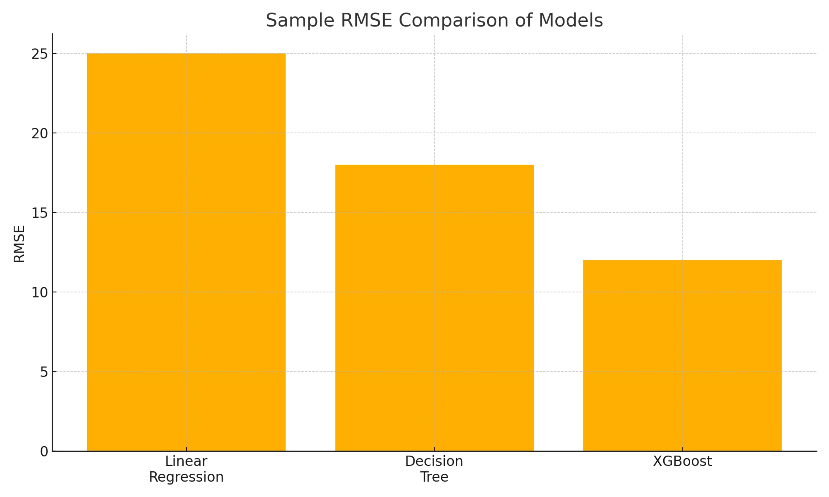
Model Performance – RMSE Comparison

Slide 12
Actual vs Predicted Demand
Graph shows how closely predicted values follow actual demand.
X-axis represents time or record index.
Y-axis represents demand quantity.
Good model predictions almost overlap with actual values.

Slide 13
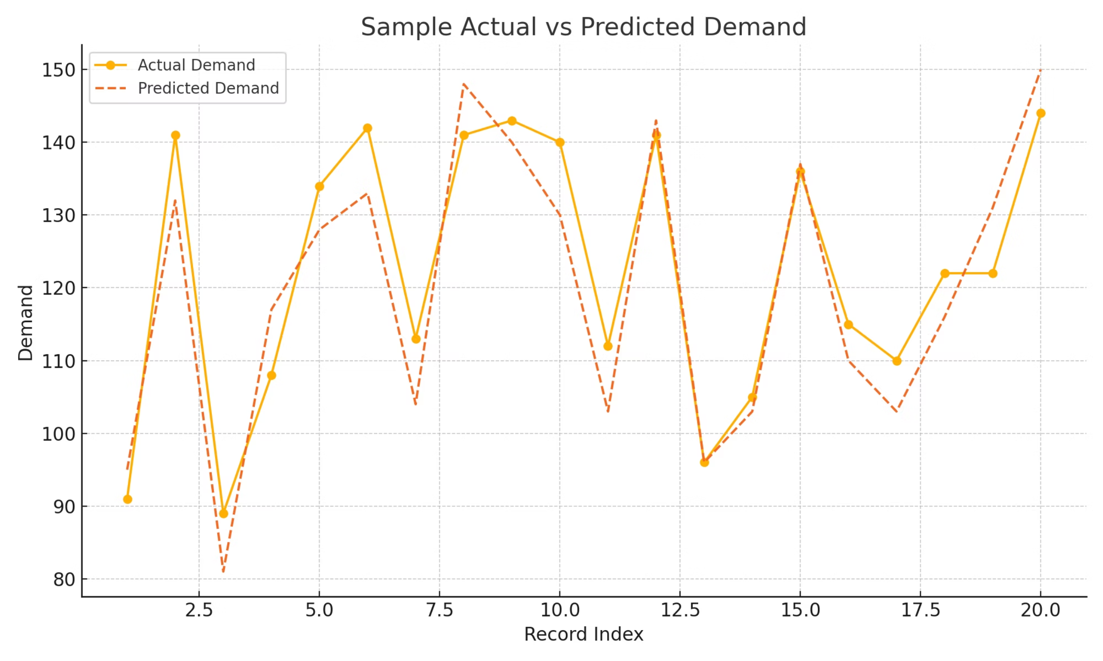
Actual vs Predicted Demand – Example

Slide 14
Conclusion
Demand forecasting using machine learning improves planning.
Models learn from historical data to predict future demand.
XGBoost Regressor provided the best sample performance.
Helps organizations reduce cost and improve customer satisfaction.

Slide 15
Future Work
Include more features like promotions, holidays, and weather.
Use advanced time-series models like ARIMA, LSTM networks.
Deploy the model as a web application/dashboard.
Continuously update the model with new demand data.

Slide 16
References
Python Libraries: pandas, numpy, scikit-learn, xgboost, matplotlib.
Machine Learning documentation and tutorials.
Research papers and articles on demand forecasting.
Any dataset source used (Kaggle or institute-provided).

Slide 17
Thank You
Presented by:
Group Members
You can edit this slide to add individual names and roll numbers.

